Slide 1
Capstone Project
Netflix Movies and TV Shows Clustering
Rupali Sawant

Slide 2
Content
Problem Statement
Data Overview
Exploratory Data Analysis
Data Visualization
Data Cleaning and Feature Engineering
Challenges faced
Conclusion

Slide 3
Problem Statement
Given is a dataset of the Netflix movies and TV Shows with details of the rating, cast, director, genre, description etc.
Explore and analyze the dataset to arrive at interesting insights
Cluster similar content through text based clustering

Slide 4

Overview
Netflix is a streaming service that offers a wide variety of award-winning TV Shows, movies ,documentaries of the internet connected device.
Whenever you have access the Netflix service , their recommendations system strives to help you to find a show or movie to enjoy with minimal effort.

Slide 5
Data Summary
-show_id : unique ID for every Movie / TV Show
-type : Identifier whether it is movie or a TV Show
-Title : title of the Movie / TV Show
-Director : Director of the Movie
-Cast : cast members of the production
-Country : country where the movie /show was produced
-Date_added : date it was added on Netflix
-Release_year : actual release year of the movie / show
-Rating : content rating of the movie / show
-Listed_in : genre
Description : the summary description-

Slide 6
Exploratory Data Analysis
7787 rows and 12 columns
No duplicates value present
Null value were present for some of the columns
TV-MA,R,PG-13, TV-14, TV-PG, NR , TV-G, TV-Y, TV-G, TV-Y7,PG,G , NC-17
Data extraction performed on year_added column
Number of movies are more than the number of TV shows

Slide 7
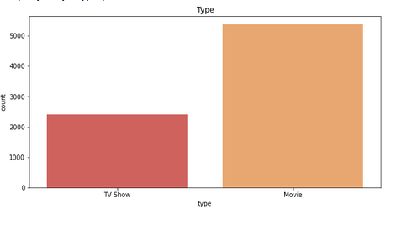
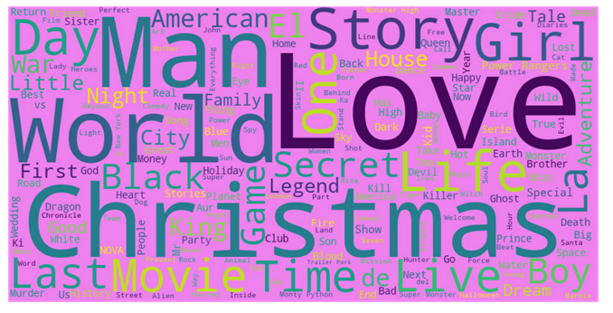
Data Visualization
As we can see that , Love, Christmas, Man , Story and World are the most utilized words for movie titles.
Number of movies is more than number of TV shows

Slide 8
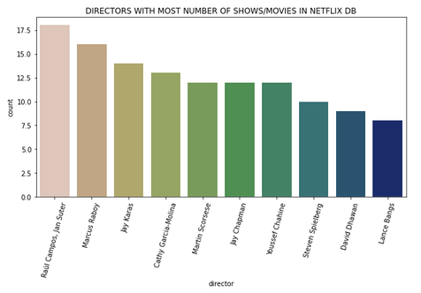
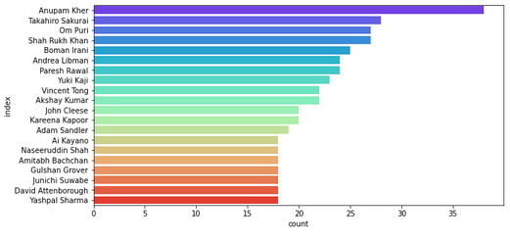
Data Visualization
Above graphs shows that the director with most number of production in our Netflix dataset.
Anupam kher is the actor with most number of productions with his name on the list

Slide 9
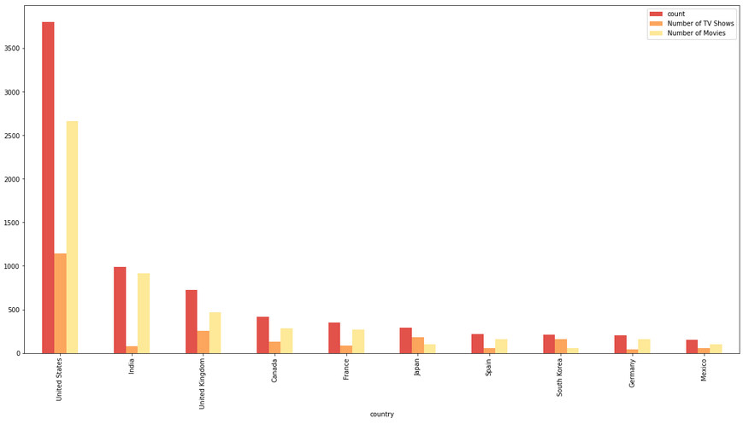
Top Countries and Productions Type
USA
India
UK
Canada
France
Japan
Spane
South Corea
Germany
Mexico

Slide 10
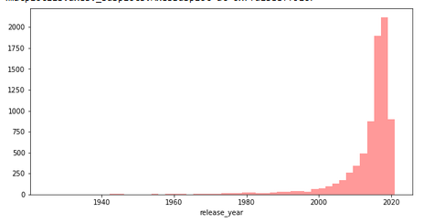
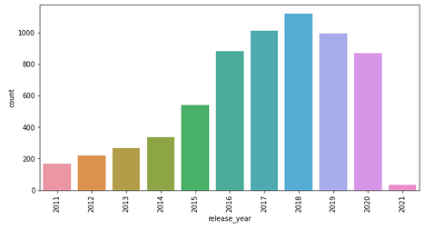
Netflix Content And Released Years
Netflix database has most movies which were release during the last decade(2010-2020) compared to all other time periods.

Slide 11
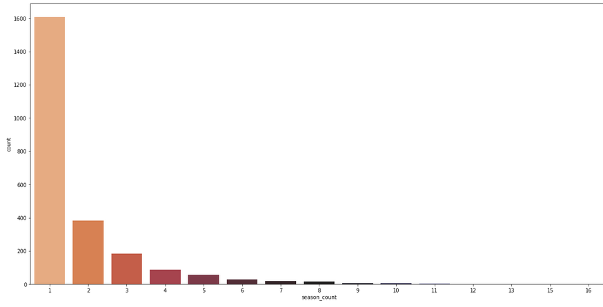
Duration of TV Shows
Most of the streamed TV Shows have only one season, Show that go beyond 3 seasons are very less in number compare to single season TV shows. This statistics can change in the future as most of these were released in the year 2017-2020

Slide 12
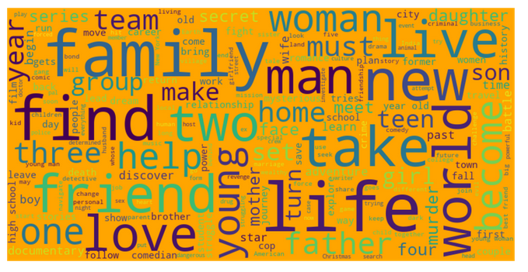
Description of most common words
Family, life, world happens to most frequent word in the description of these Netflix movies / shows

Slide 13
Data Cleaning and Feature Engineering
Textual features are combined to one column ‘combined_text_feat’ column
Text cleaning was perform on this column
Converted to lower case
Removed symbols, special character and stopwords
Removed 2 letter words
Stemming is also perform on the column text

Slide 14
Text Based Clustering
TF-IDF Vectorization is performed on the data to perform clustering
Kmeans Clustering is used here
Optimal number of cluster is 25
Conclude after the Elbow and Silhouette test
Silhouette score with 25 clusters in 0.0279
Clusters are identified for all the movies and TV shows in the dataset
Additionally the recommendation algorithm was also perofrm on the data set

Slide 15
Optimal Cluster Number
Elbow Method – The method consist of plotting the explain variation as a function of the number of clusters and picking the elbow of the curve as the number of cluster to use.
Silhouette Method – The silhouette value is a measure of how similar an object is to other cluster . The silhouette range between -1 to +1 .

Slide 16
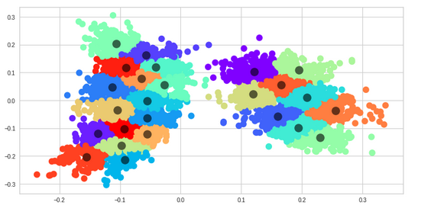
Dimenstionality Reduction
We applying PCA for dimenstionality reduction

Slide 17
Challenges Faced
Complex Dataset
Clusters are too close to each other
As the cluster number increase , time taken to fit the cluster also increase.

Slide 18
Conclusion
United states provide the most number of movies and shows followed by India and United kingdom.
TV-MA rated content is maximum in number in the dataset. This rating indicates that the content is for mature and adult audience above the age of 17.
There is an exponential raise in the number of TV shows and movies distributed by Netflix in the recent years.
Optimal number of cluster were found out to be 25 with silhouette coefficient value of 0.0279

Slide 19
Thank You

